Slide 1


Who is ready to be a data scientist?
By: Randolf F, Macda G, Hailegiorgis K, Moe S, Selamawit M

Slide 2

Introduction
Interested in analyzing the job market in the U.S. for Data Scientists
Began with the following questions to help us get started with the analysis
Where can we look into applying once we are done with this class?
Which states have a demand for Data Scientists?
Which cities within those states have the demand for Data Scientists?
Which companies are hiring Data Scientists?
What positions titles are these companies looking for?
What are the salaries for these positions? And what is the salary difference between states and cities?

Slide 3
Data & Tools
Utilized Kaggle for the following data:
Positions
Companies
Cities
States
Bureau of Labor of Statistics data:
Salaries
Software used:
Tableau
R

Slide 4
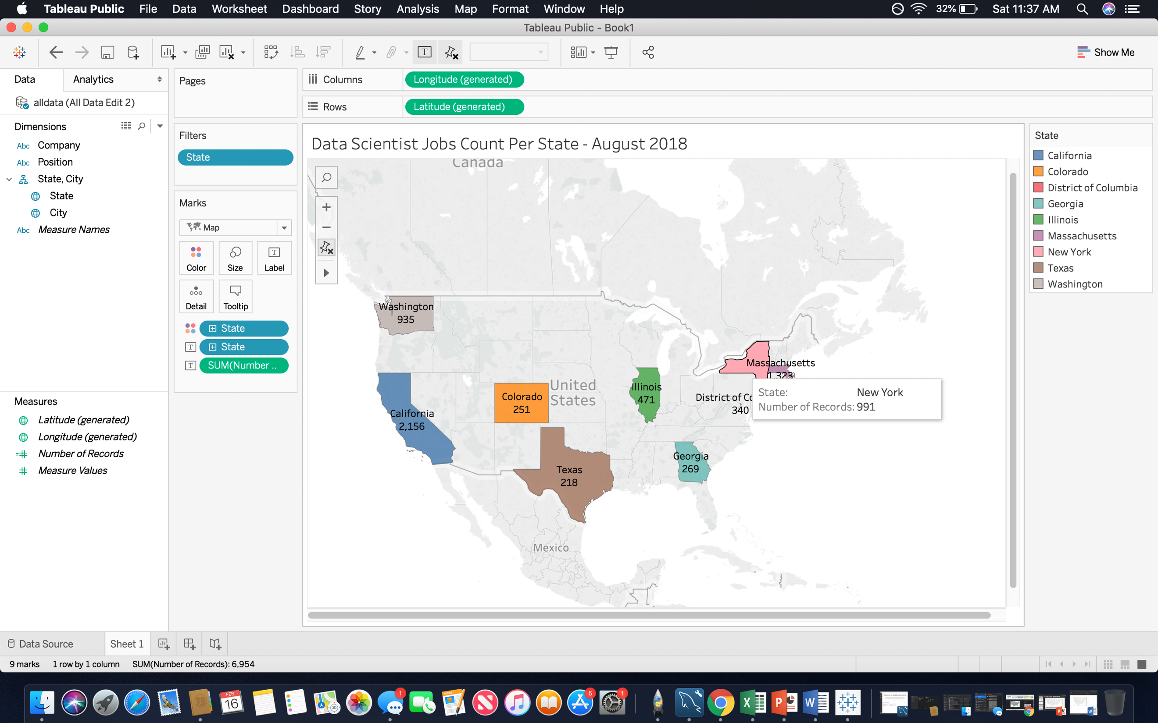
Count of Jobs In the specified states
Data Analysis 1

Slide 5
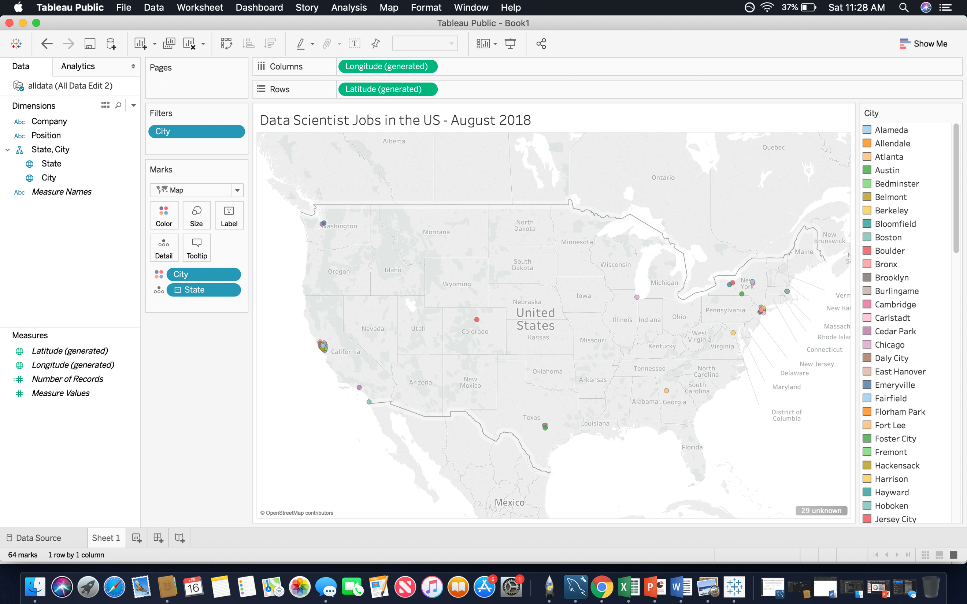
Jobs in cities
Data Analysis 2

Slide 6
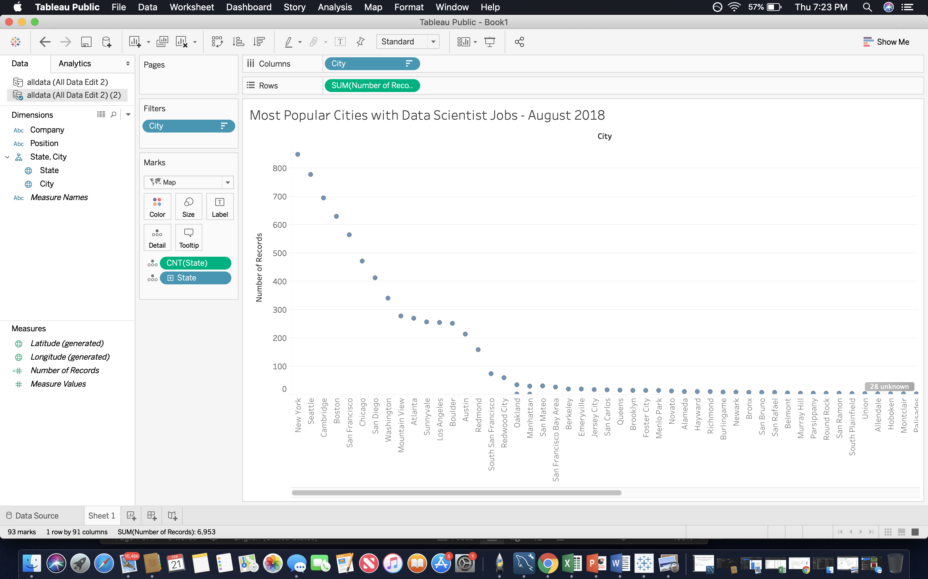
Count of records per cities
Data Analysis 3

Slide 7
R Regression
Data Analysis 4
Data Analysis 4

Slide 8
R Regression
Data Analysis 5

Slide 9
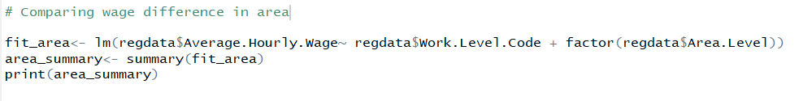
R Regression
Data Analysis 6

Slide 10
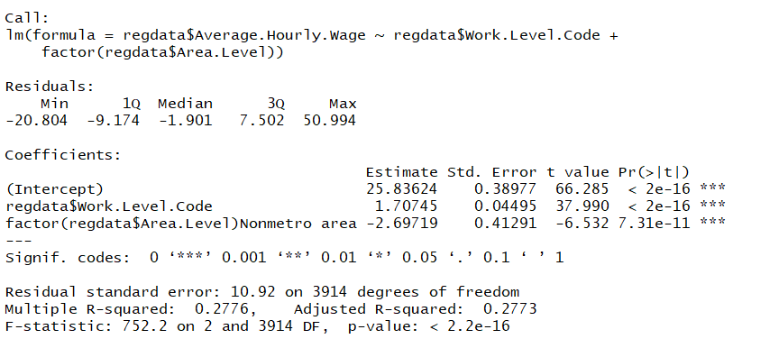
R Regression
Data Analysis 7

Slide 11
Discussion
Discuss your findings. Did you find what you expected to find? If not, why not? What inferences or general conclusions can you draw from your analysis?
Notes:
The following are in order of the states that have the most jobs:
California
Massachusetts
Washington
New York
Illinois
District of Columbia
Colorado
Texas

Slide 12
Post Mortem
Discuss any difficulties that arose, and how you dealt with them
Discuss any additional questions that came up, but which you didn't have time to answer: What would you research next, if you had two more weeks?

Slide 13

Questions
Open-floor Q&A with the audience

